Slide 1



ABAP on Hana s/4 Hana Training
Day 7
contact@anubhavtrainings.com

Slide 2

Agenda – Day 7
Calculation View
Implementing OIA Using Calculation View
Concept of Delivery Unit
Method’s for Consume HANA Objects
ADBC ( ABAP Database Connectivity )

Slide 3
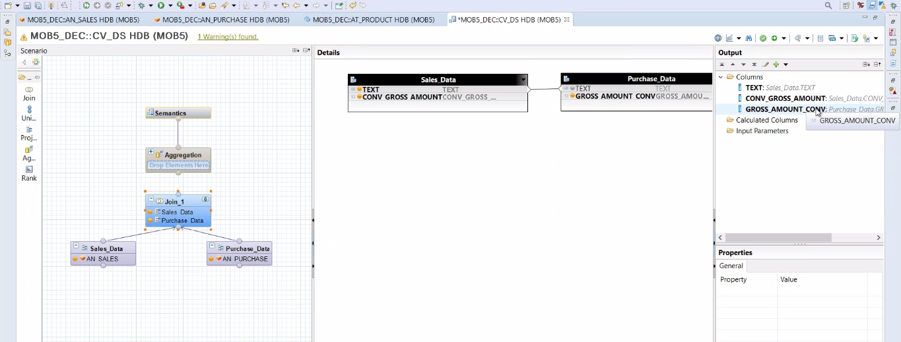
Calculation View
Calculation views provide a way to do flexible, complex logic in the database. They are built on top of one or more analytic or attribute views and allow you to do calculations after aggregation and grouping. Calculations are generally done after grouping at the attribute level and after aggregation at the analytic level.

Slide 4

OIA Scenario Using Calculation View
Mr. James told about me to the CIO of the company last week on Christmas dinner. The CIO is very impressed by listening my stories how I helped Mr. James. Now he want me to help him as well.
He called me for a 1:1 meeting this morning. He was a secret task by the CEO of the co. Since quite a long time there were multiple escalations going on in co. for unpaid bills to their vendors and also customers who are unhappy due to unavailability of stocks.

Slide 5
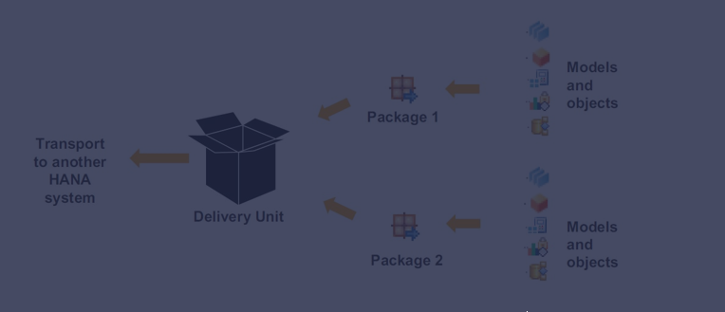
Concept of Delivery Unit
Delivery units are SAP HANA specific packages that can be used to install content, transport data models and applications developed on the SAP HANA platform. The delivery unit management window can be accessed through the 'Modeler Perspective' in SAP HANA Studio.

Slide 6
Method’s to Consume HANA Objects
01
ADBC
ABAP Database
Connectivity
02
View Proxy
Proxy is used as an Interface to transfer
or receive from or to the ABAP system
03
Mr. X
ABAP CDS
Core Data & Services

Slide 7

ABAP Database Connectivity ( ADBC )
System < SAP Net viewer 7.4
SAP offers built-in framework called ADBC framework which allows us to bypass the DB abstraction layer and directly communicate with underlaying DB. In this communication, we need to use Native SQL.
Pros
Allows all sorts of calls to DB
Native SQL
Only approach for lower NW
Cons
Too technical
Debugging is difficult
Error handling
Exercise ADBC Code

Slide 8

End of Day 7
Trainer: Anubhav Oberoy & Shubham Singh

Slide 9

Trainer: Anubhav Oberoy & Shubham Singh

Slide 10
THANK YOU
If you cannot do
great things, do small things in a great way.
Anubhav Oberoy & Shubham Singh
https://www.anubhavtrainings.com

Slide 11


We’re committed to empower you to be
Most Desirable Resource
through powerful training solutions.
We build the workforce of the future.
250+
Corporate Clients
30,000+
Learners Trained
25000+
Learners Placed
FREE WEBINARS
Sign up for free webinars with industry experts every fortnight!
Enroll Now!
Contact us today!
https://anubhavtrainings.com/

Slide 12




More from AnubhavTrainings.com

